Slide 1

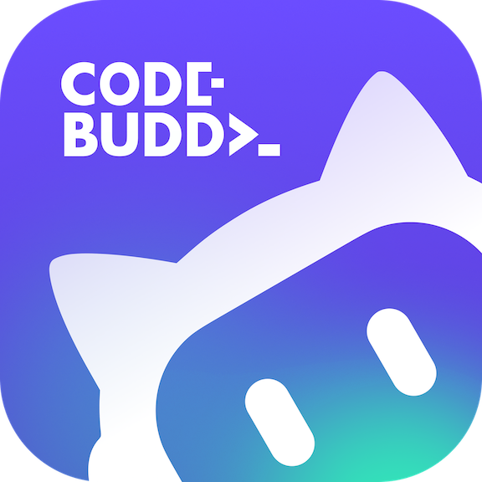






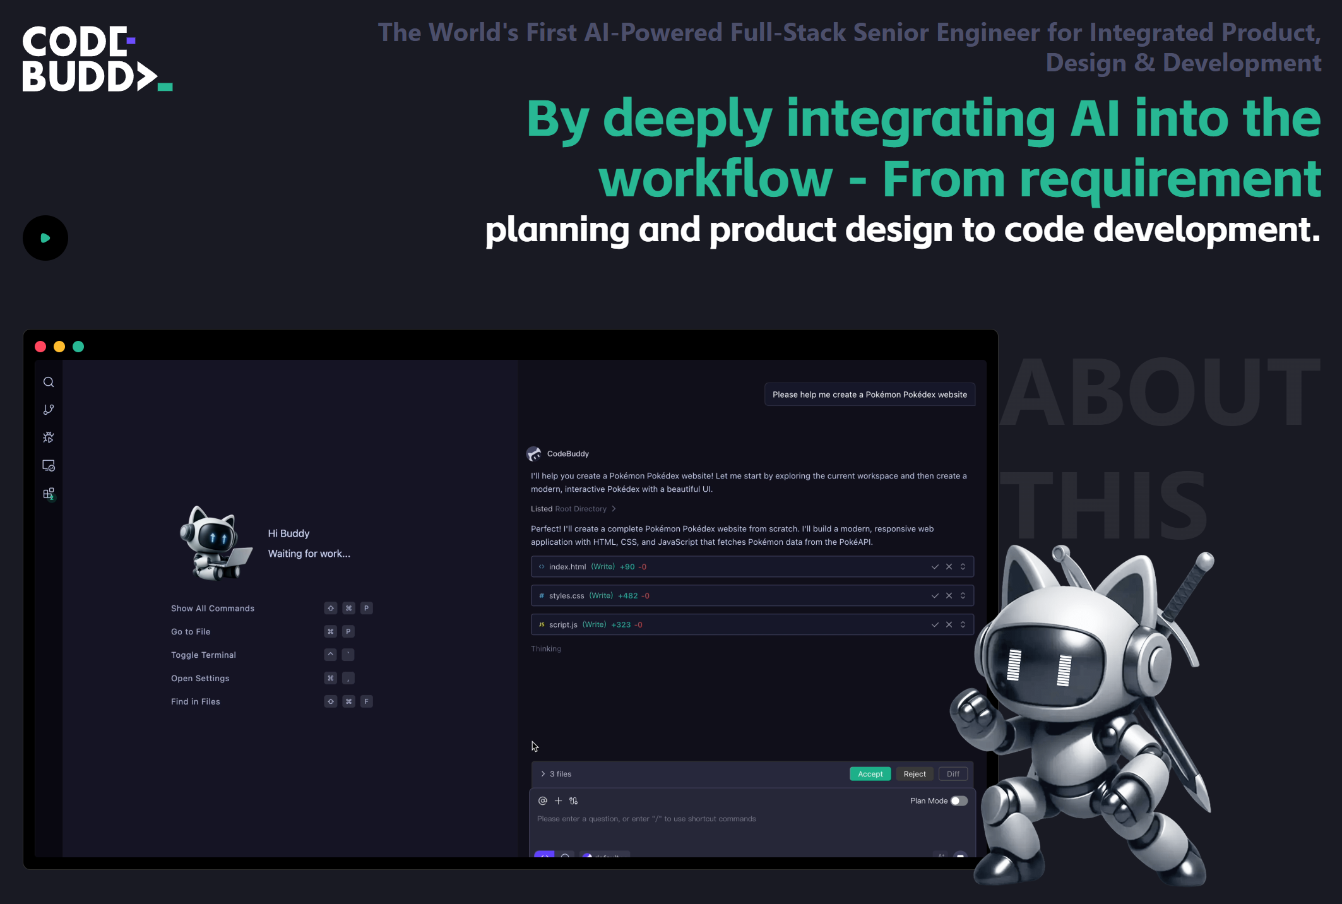
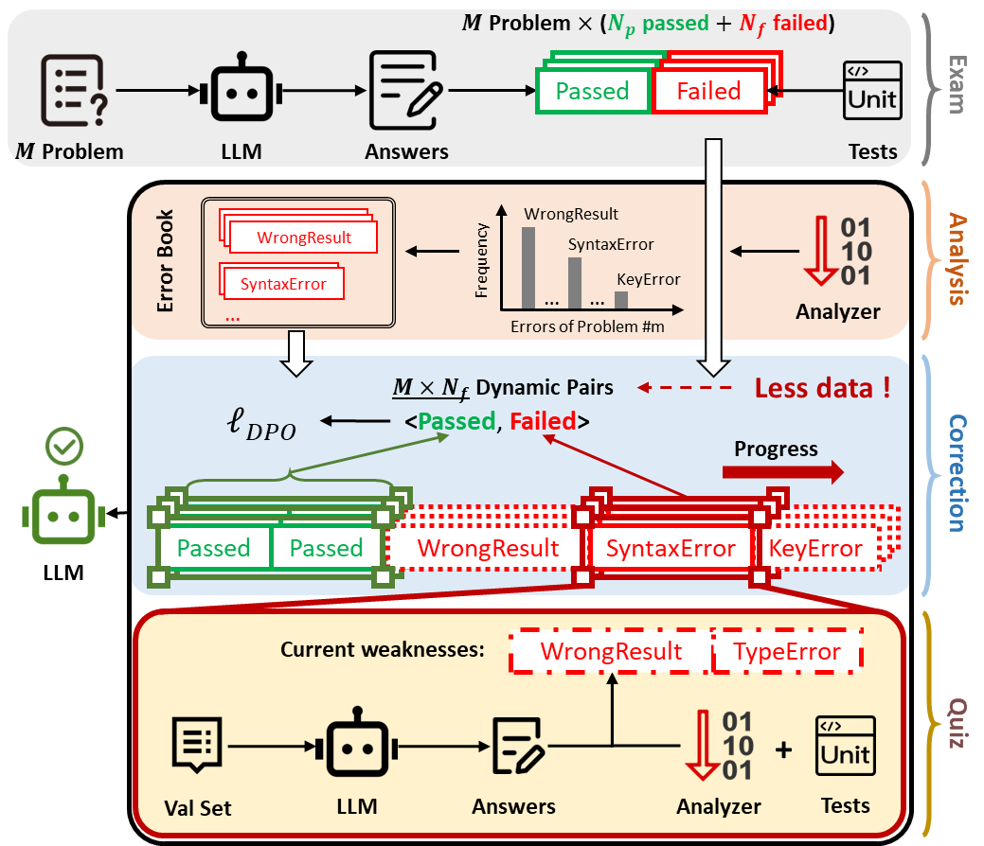
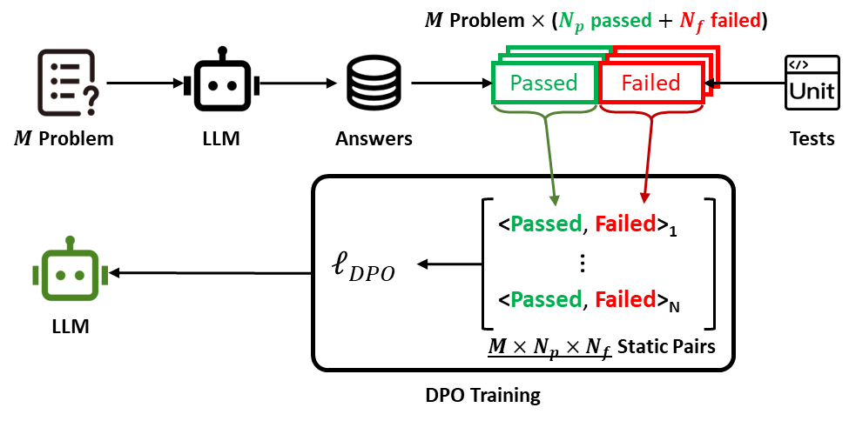
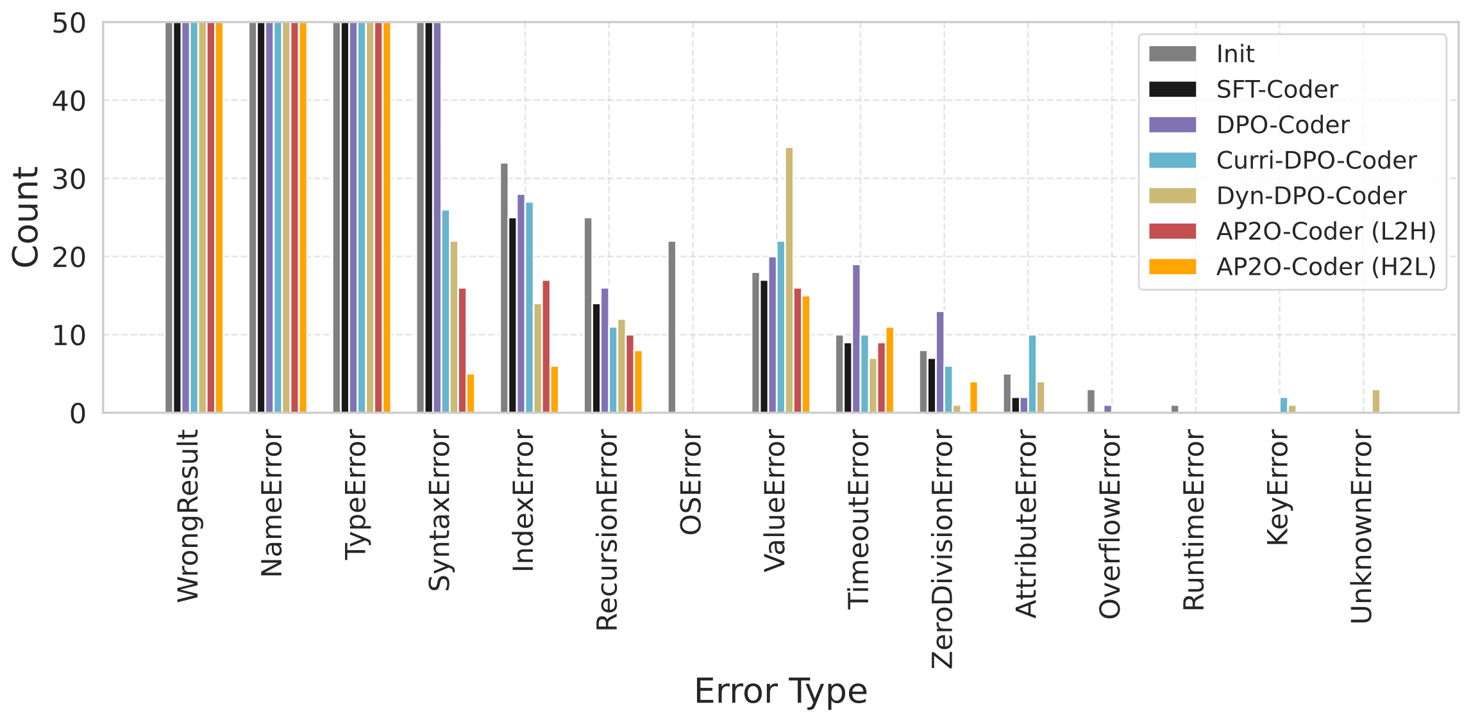
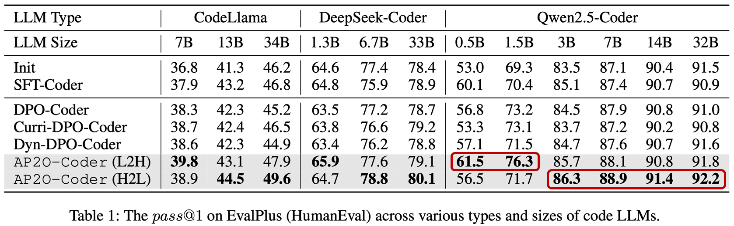
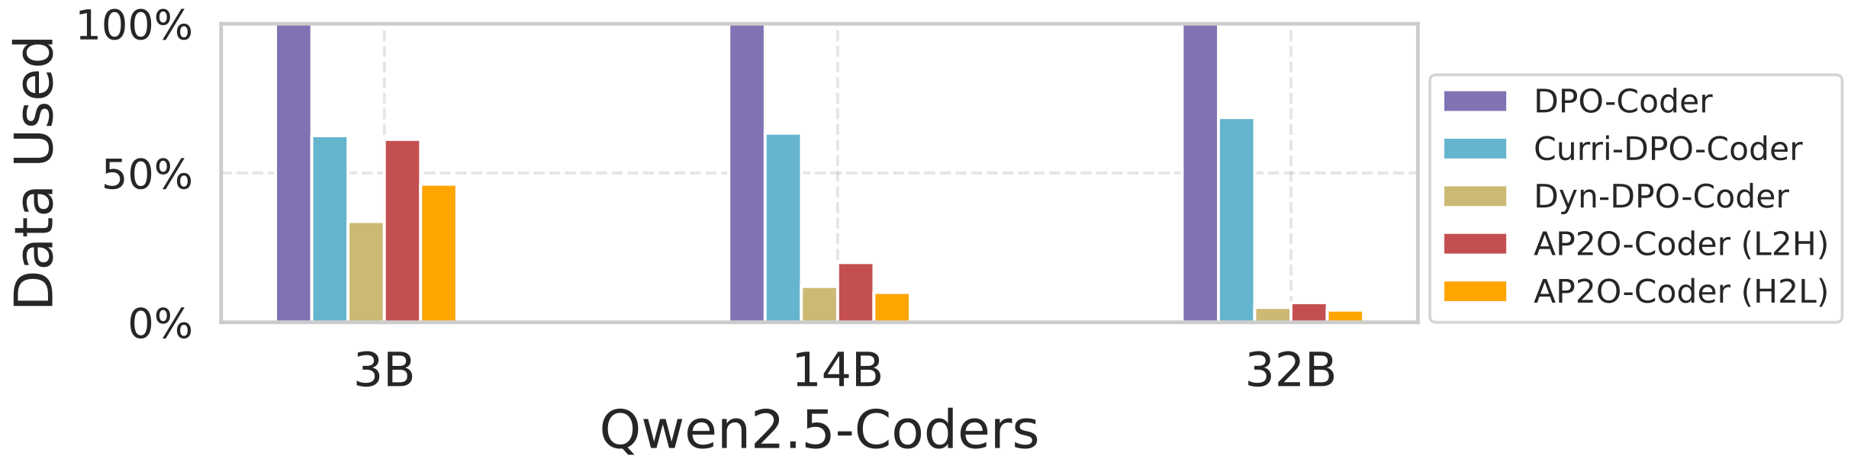
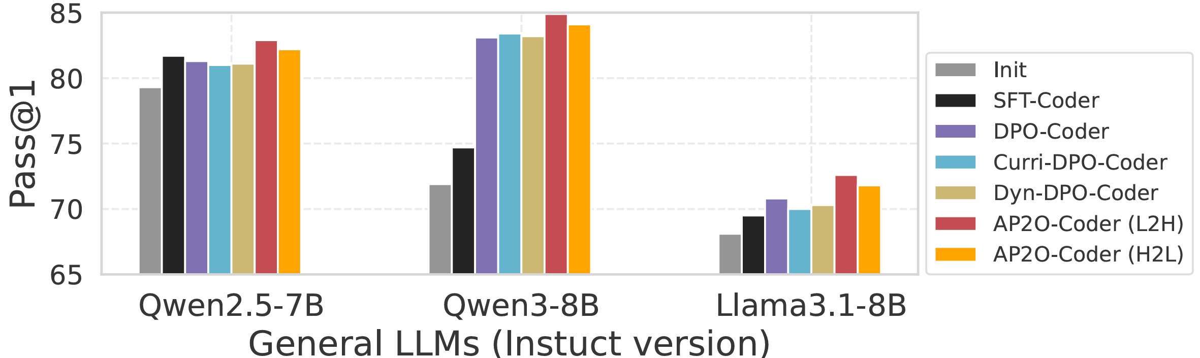





AP2O-Coder: Adaptively Progressive Preference Optimization for Reducing Compilation and Runtime Errors in LLM-Generated Code
Jianqing Zhang, Wei Xia, Hande Dong, Qiang Lin, Jian Cao
AI Coding
Overview
Code
Hiring !!!
CodeBuddy, Cursor, Claude Code, Trae, etc.
Code generation, code editing, code agent, etc.
Problem: LLM-generated code has compilation or runtime errors
Goal: Reduce code errors, improve pass rate & acceptance rate
Solution: Progressive optimization + adaptive replay
Results: pass@k +3% for 0.5B~34B LLM on EvalPlus, LiveCodeBench
Models: Qwen2.5-Coder, CodeLlama, DeepSeek-Coder, Qwen2.5, Llama3, Qwen3
Bonus: Reduce data requirement greatly (only using 4%~60% data)
Findings:
  Poor models: Progressing from low to high error frequency
  Strong models: Progressing from high to low error frequency
Me
Mentor
Our Method
Progressive preference optimization + adaptive error replay
Existing Methods
https://www.codebuddy.ai
Traditional DPO training for code generation
  Problem 1: Unawareness of code errors
  Problem 2: cannot focus on specific error types (KeyError, etc.)
Experiments
AP2O reduces code errors
AP2O (H2L) is better for large models.
  Concentration then exploration fits mature LLMs
  H: LLM sees identical error types in adjacent updating steps - specification
  L: LLM sees various error types in adjacent updating steps - generalization
AP2O is also sample efficient (only using 4%~60% data)
AP2O can adapt general LLMs to the code domain
tsingz
tsingz@sjtu.edu.cn
TsingZ0

